Slide 1
Flu Strains, Hospitality, and Mortality
Walter Hamson
Christian Blomgren
Jay Manion

Slide 2
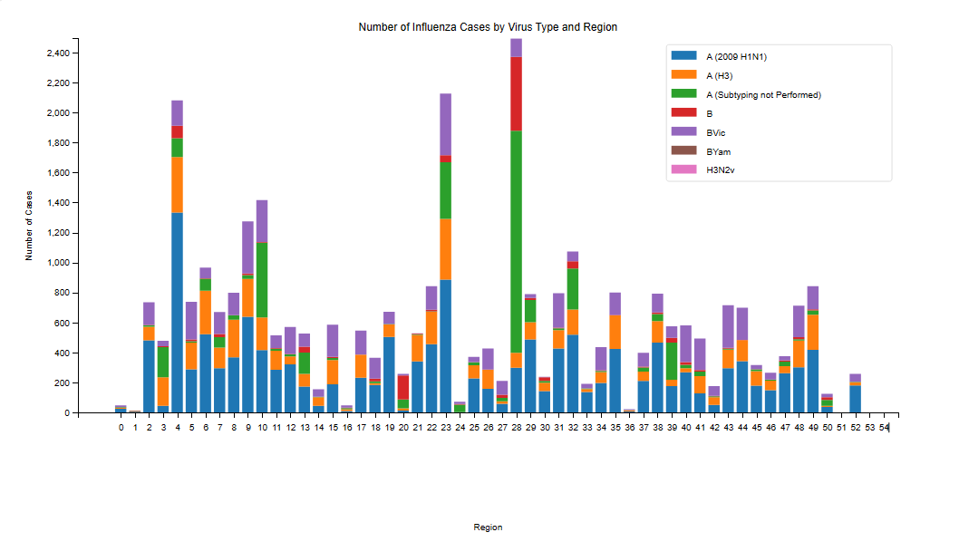
Strains – Walter
x

Slide 3
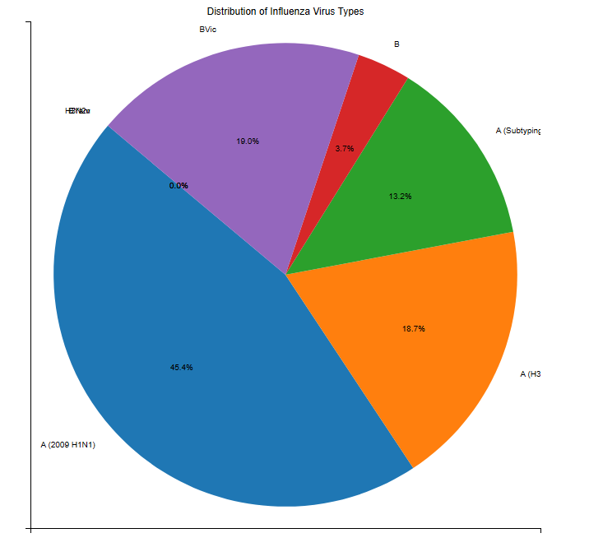
Strains – Walter
x

Slide 4
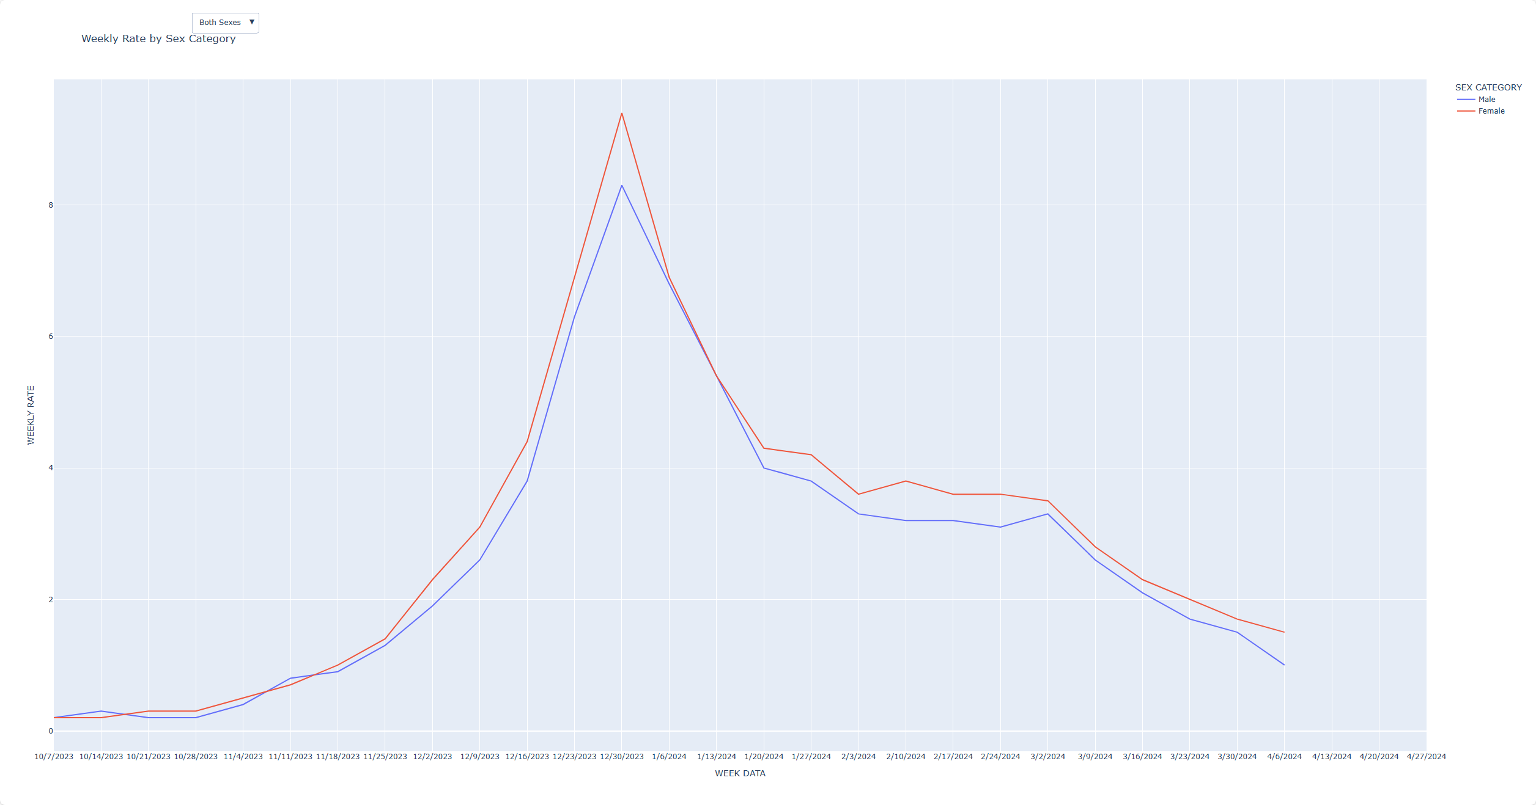
Hospitalizations by Sex - Jay
x

Slide 5
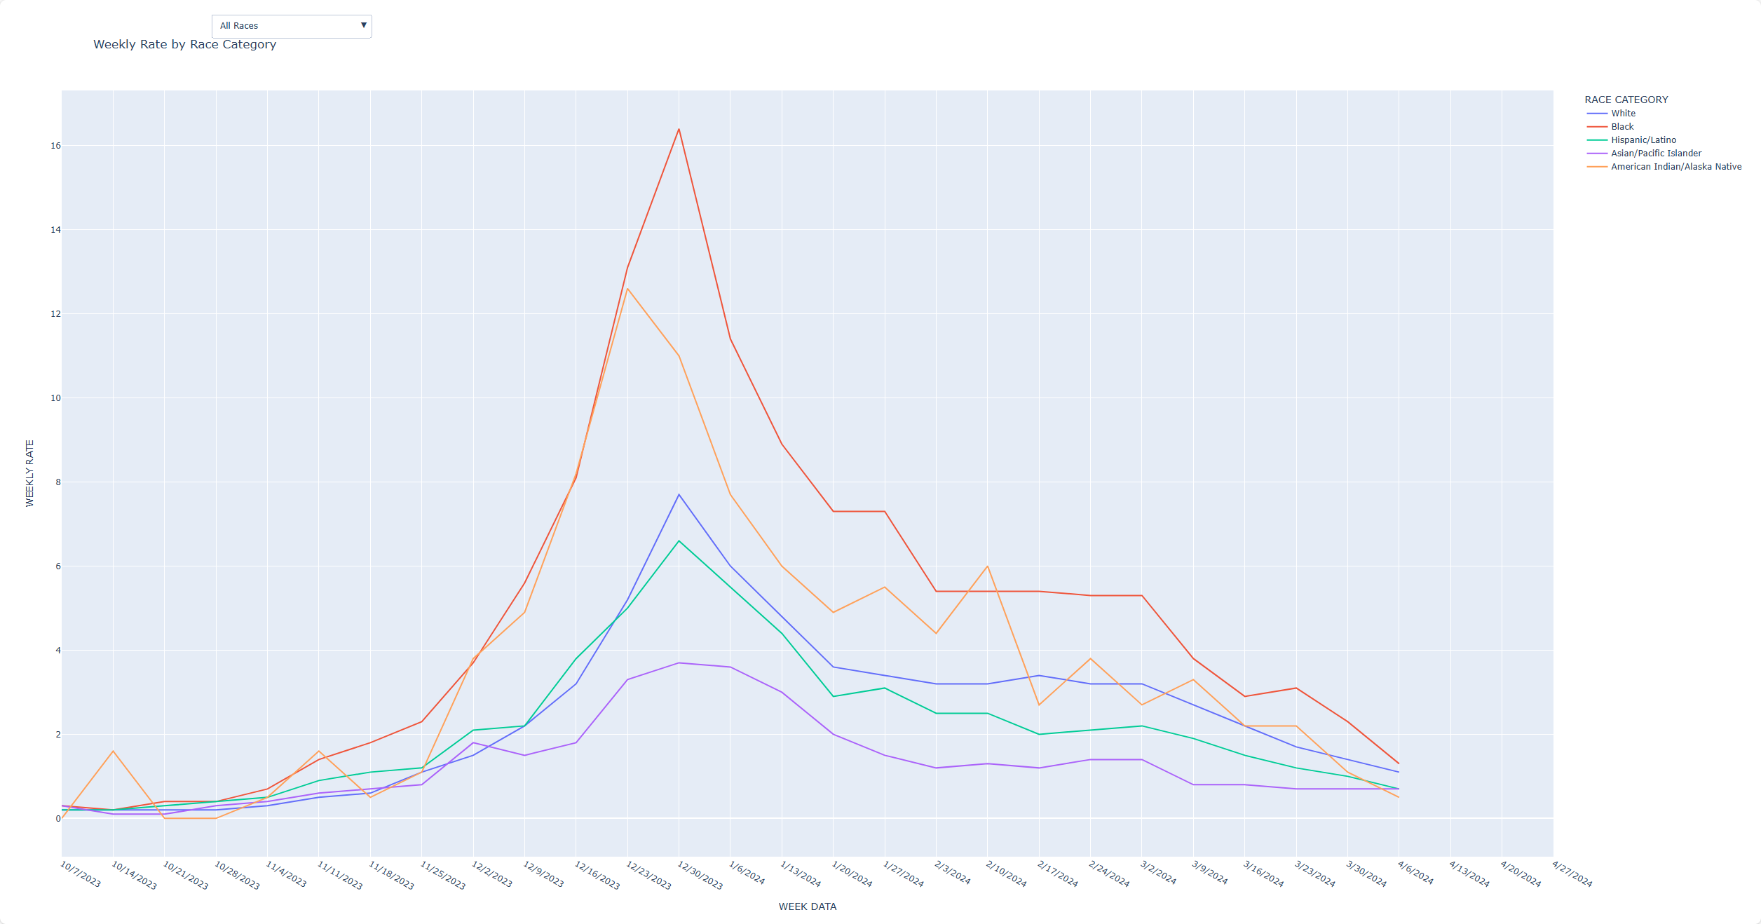
Hospitalizations by Race- Jay
x

Slide 6
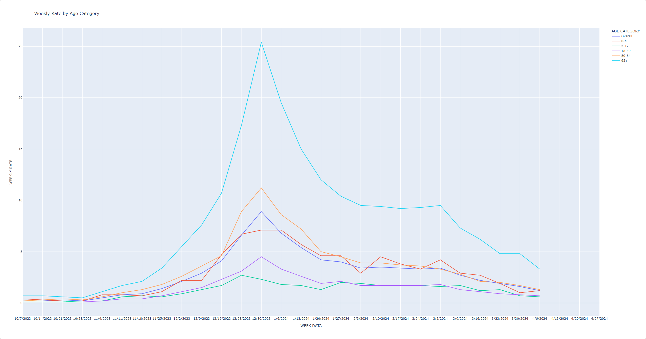
Hospitalizations by Age - Jay
x

Slide 7
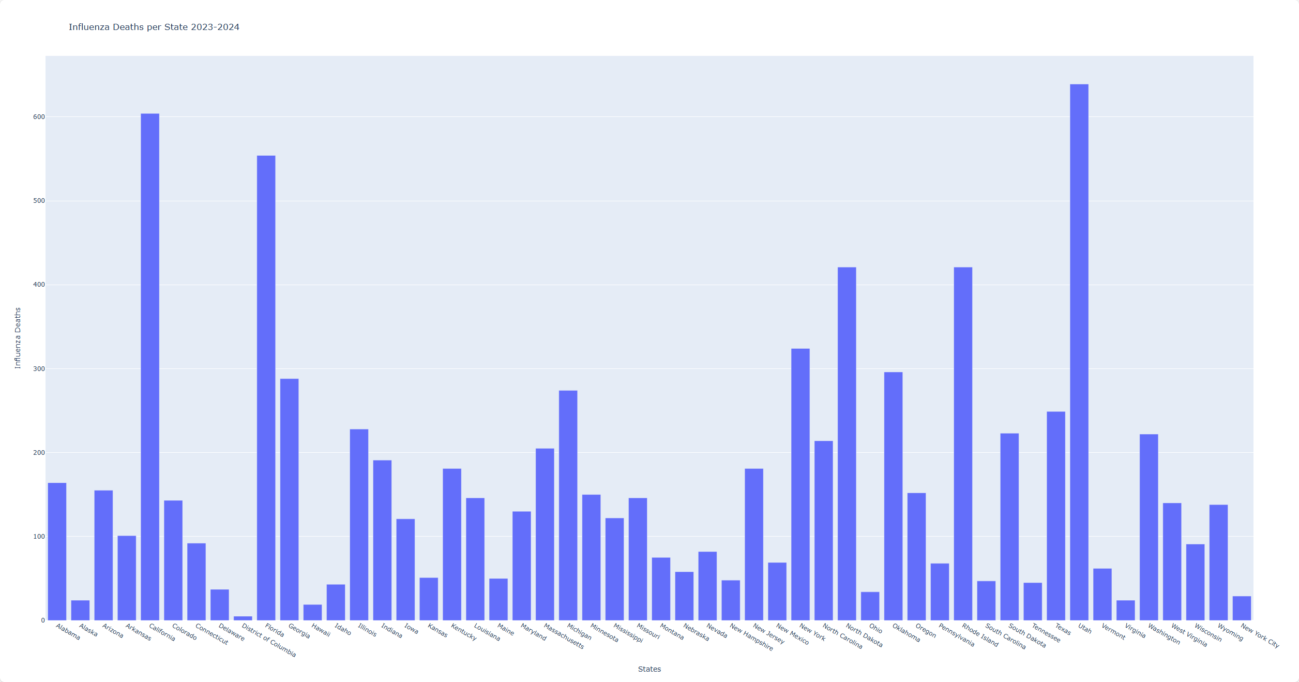
Mortality - Christian
x

Slide 8
Wrap-up

Slide 9
Questions?

